Slide 1
Particle Swarm Optimization for Traveling Salesman Problem
Kang-Ping Wang, Lan Huang, Chun-Guang Zhou and Wei Pang
Proceedings of the Second International Conference on Machine Learning and
Cybernetics, Vol. 3, pp. 1583 ~ 1585 ,2003
Presenter : Hsiang-Yi Weng
Date : Jan. 13, 2009

Slide 2
Abstract
This paper proposes a new application of Particle
Swarm Optimization for Traveling Salesman Problem.
We have developed some special methods for solving
TSP using PSO. We have also proposed the concept of
Swap Operator and Swap Sequence, and redefined
some operators on the basis of them, in this way the
paper has designed a special PSO. The experiments
show that it can achieve good results.

Slide 3
Traveling Salesman Problem
Given a number of cities and the costs of travelling from any
city to any other city, what is the least-cost round-trip route that
visits each city at least once and then returns to the starting city?
B
6
 | A | B | C | D
A | 0 | 6 | 4 | 4
B |  | 0 | 3 | 2
C |  |  | 0 | 5
D |  |  |  | 0
2
A
3
D
4
4
5
A → C → B → D → A cost:13
C

Slide 4
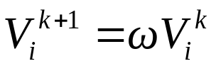
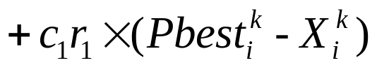
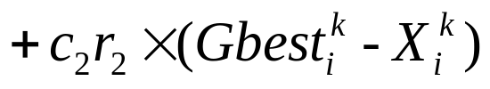
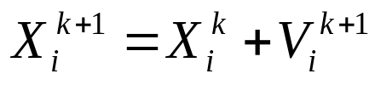
Particle Swarm Optimization
Particle swarm optimization (PSO) is a swarm intelligence based algorithm to find a solution to an optimization problem in a search space, or model and predict social behavior in the presence of objectives.

Slide 5
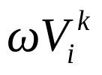

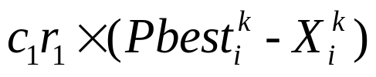
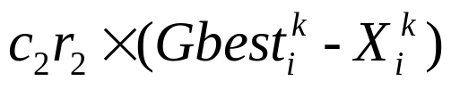



Particle Swarm Optimization

Slide 6

Particle Swarm Optimization

Slide 7

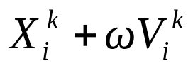
Particle Swarm Optimization

Slide 8
Swap Operator and Swap Sequence
A:(1,2,3,4,5)
B:(2,3,1,5,4)
A(1)=B(3)=1 SO(1,3)
B₁=B+S(1,3)
B₁:(1,3,2,5,4)
A(2)=B₁(3)=2 SO(2,3)
B₂:(1,2,3,5,4)
A(4)=B₂(5)=4 SO(4,5)
B₃:(1,2,3,4,5)
SS=A-B=(SO(1,3), SO(2,3), SO(4,5))

Slide 9
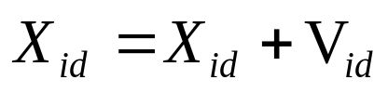
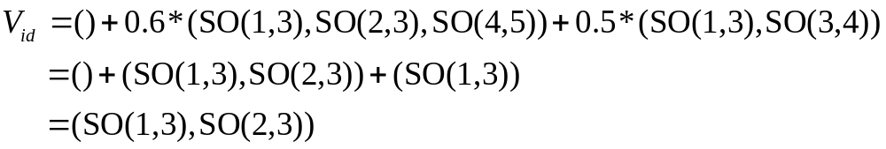
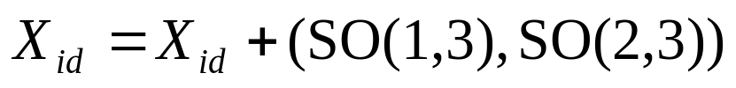
Redefine some operators

Slide 10
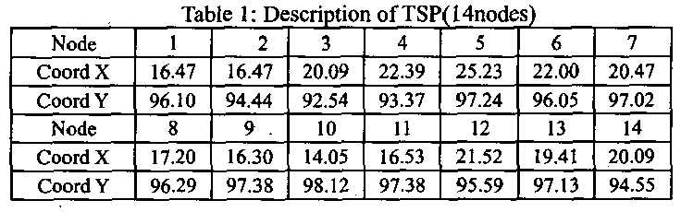
Experiment Results
Data
The number of the particles: 100
The number of the iterations of the algorithm: 20000
The size of search space: 2000000

Slide 11
Experiment Results
1 → 10 → 9 → l1 → 8 → 13 → 7
→ 12 → 6 → 5 → 4 → 3 → 14 →2
Cost: 30.8785 (Equal to the optimal solution)

